Slide 1

7th Grade Math
Unit 8, Lesson 2 Quotient Laws of Exponents Volume 2, pg. 10

Slide 2


Benchmark
MA.7.NSO.1.1
Know and apply the Laws of Exponents to evaluate numerical expressions and generate equivalent numerical expressions, limited to whole-number exponents and rational number bases.
volume 2, pg. 10

Slide 3
Integrated Mathematical Thinking and Reasoning Standards
MA.K12.MTR.1.1 Actively participate in effortful learning both individually and collectively.
MA.K12.MTR.4.1 Engage in discussions that reflect on the mathematical thinking of self and others.
MA.K12.MTR.5.1 Use patterns and structure to help understand and connect mathematical concepts.
MA.K12.MTR.6.1 Assess the reasonableness of solutions.
volume 2, pg. 10

Slide 4

Learning Target
I can explain and use the quotient of powers, power of a quotient, and zero exponent laws.
volume 2, pg. 10

Slide 5

Warm-Up
volume 2, pg. 10

Slide 6
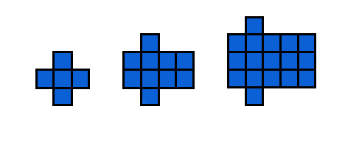
8.2.1 Warm-Up: Use a Pattern
Look at the pattern shown in the figures below. Work with your partner to answer the questions.
Describe the pattern in words.
If the pattern continued, how many squares would be in Figure 10?
Figure 1 Figure 2 Figure 3
volume 2, pg. 10

Slide 7

Activity
volume 2, pg. 11

Slide 8

8.2.2 Activity: Station 1: Quotient of Powers Exponent Law
Work with your partner or a small group to complete three stations involving the laws of exponents.
Task 1:
Review the steps Rosa, Victor, and Emma each used to generate an equivalent expression. Then, answer the questions that follow.
volume 2, pg. 11

Slide 9
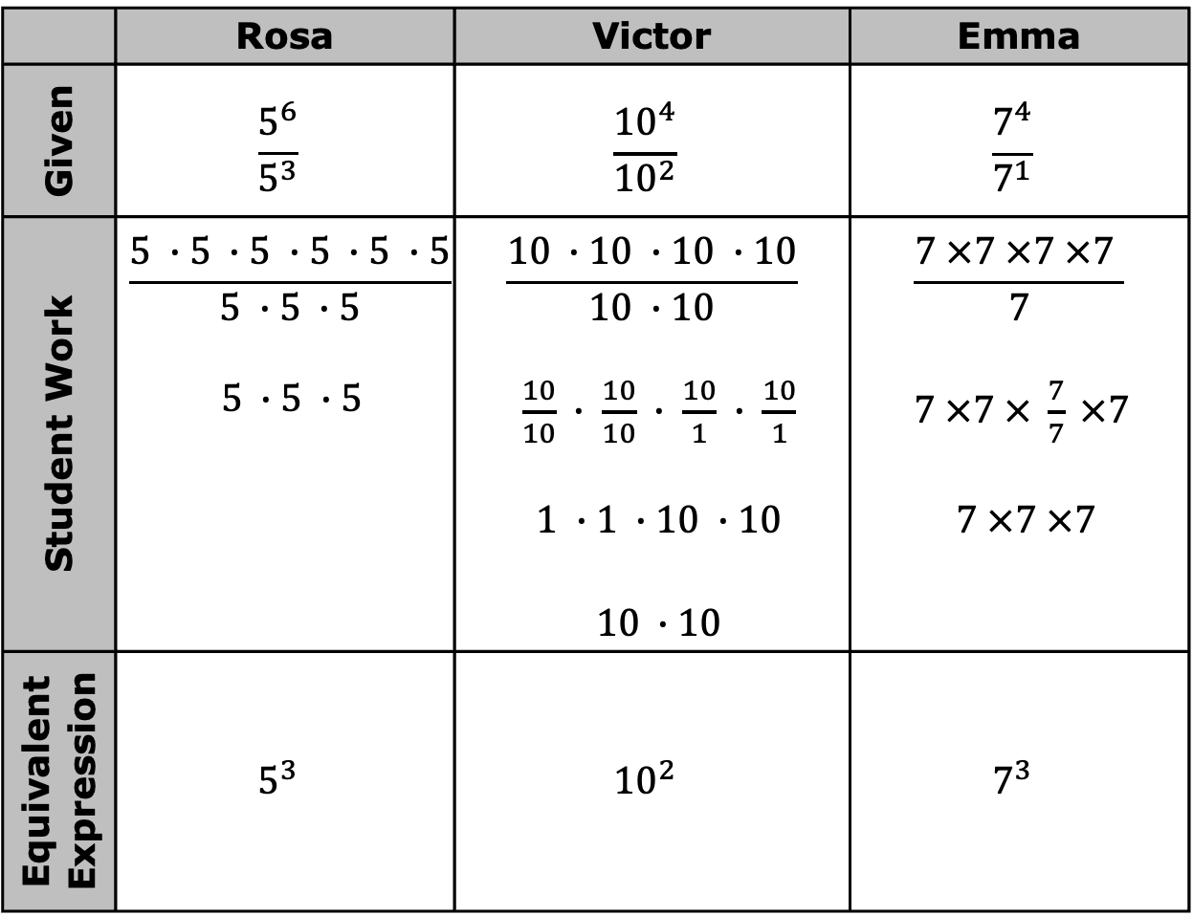
 | Rosa | Victor | Emma
Given | $$\frac{5^{6}}{5^{3}}$$ | $$\frac{{10}^{4}}{{10}^{2}}$$ | $$\frac{7^{4}}{7^{1}}$$
Student Work | $$\frac{5 ∙5 ∙5 ∙5 ∙5 ∙5}{5 ∙5 ∙5}$$ $5 ∙5 ∙5$ | $$\frac{10 ∙10 ∙10 ∙10}{10 ∙10}$$ $\frac{10}{10} ∙ \frac{10}{10} ∙ \frac{10}{1} ∙ \frac{10}{1}$ $1 ∙1 ∙10 ∙10$ $10 ∙10$ | $$\frac{7 ×7 ×7 ×7 }{7}$$ $7 ×7 × \frac{7}{7} ×7$ $7 ×7 ×7$
Equivalent Expression | $$5^{3}$$ | $${10}^{2}$$ | $$7^{3}$$
volume 2, pg. 11

Slide 10
What do you notice about the bases of the numerator and denominator of each given exponential expression?
Circle the exponents in the given exponential expression and circle the exponent in the equivalent expression each student created. How are they related?
volume 2, pg. 11

Slide 11

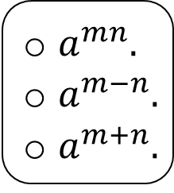
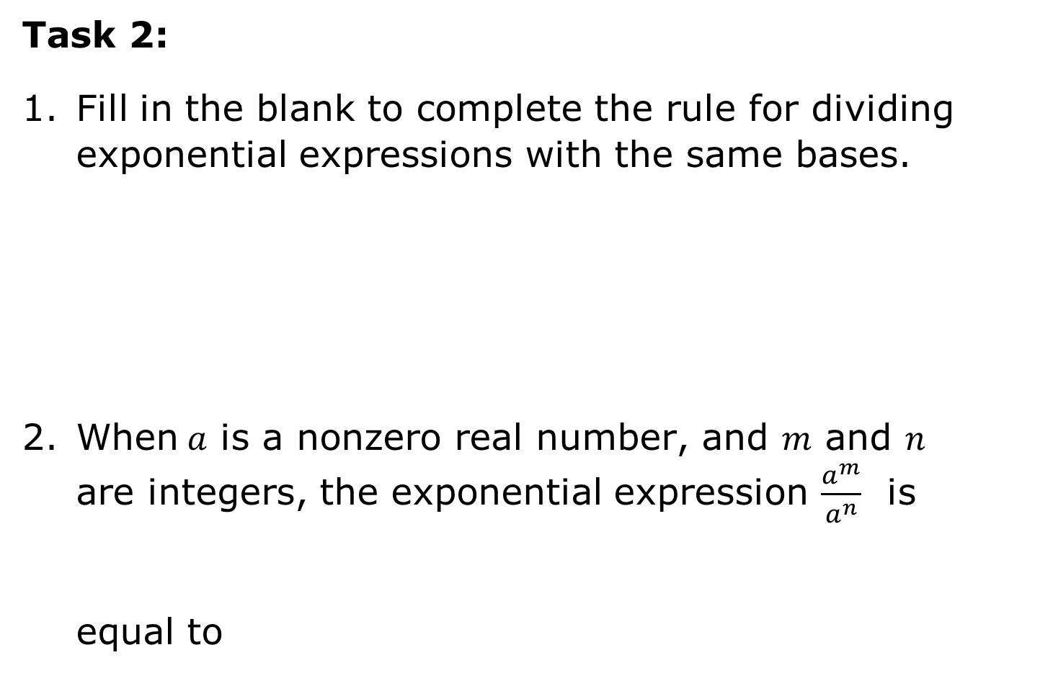
Task 2:
Fill in the blank to complete the rule for dividing exponential expressions with the same bases.
When$a$ is a nonzero real number, and $m$ and $n$ are integers, the exponential expression $\frac{a^{m}}{a^{n}}$ is equal to
When dividing two powers that have the same nonzero base, keep the base and the exponents. This is called the quotient of powers exponent law.
$a^{mn}.$
$a^{m−n}.$
$a^{m+n}.$
volume 2, pg. 11

Slide 12

Task 3: Show your steps of applying the quotient of powers exponent law to evaluate.
$\frac{{\left(−2\right)}^{6}}{{\left(−2\right)}^{3}}$
$\frac{{\left(3\right)}^{6}}{{\left(3\right)}^{2}}$
$\frac{{\left(−7\right)}^{4}}{{\left(−7\right)}^{1}}$
volume 2, pg. 11

Slide 13
Activity
volume 2, pg. 12

Slide 14
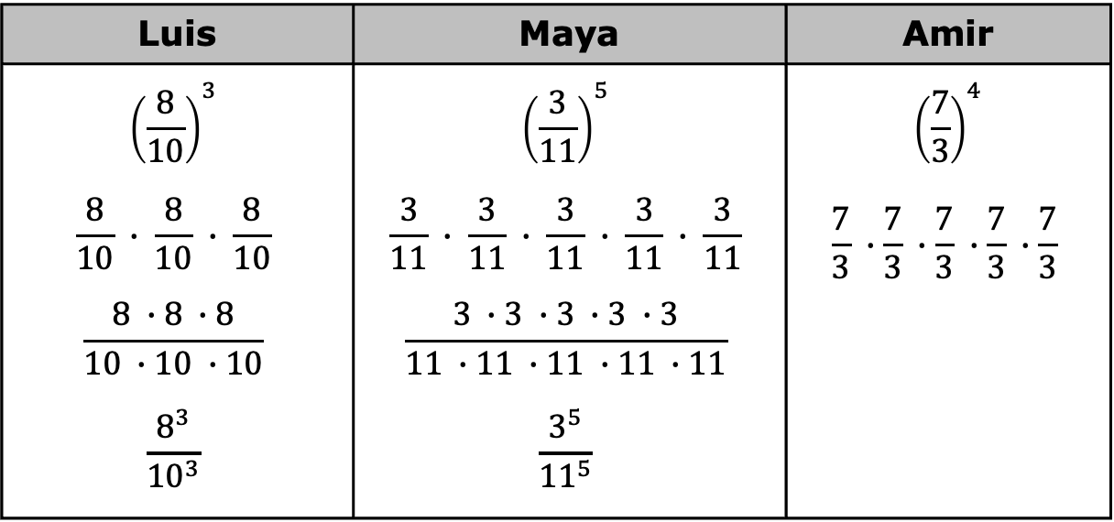
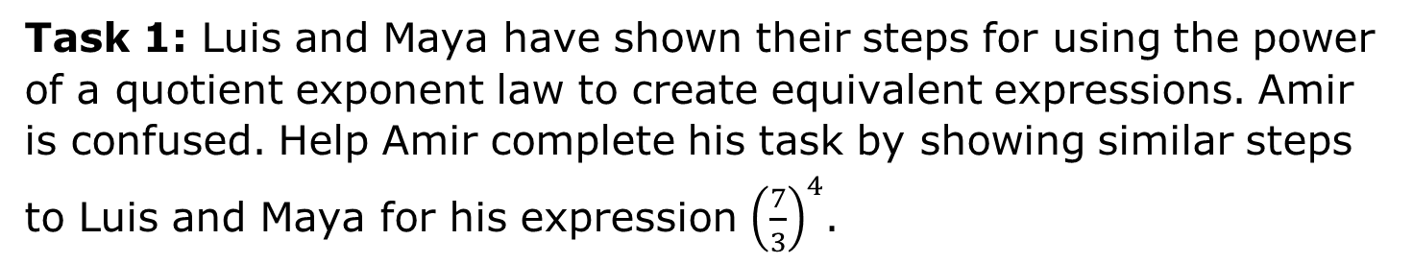
8.2.3 Activity: Station 2: Power of a Quotient Exponent Law
Task 1: Luis and Maya have shown their steps for using the power of a quotient exponent law to create equivalent expressions. Amir is confused. Help Amir complete his task by showing similar steps to Luis and Maya for his expression ${\left(\frac{7}{3}\right)}^{4}$.
Luis | Maya | Amir
$${\left(\frac{8}{10}\right)}^{3}$$ $$\frac{8}{10} ∙ \frac{8}{10} ∙ \frac{8}{10}$$ $$\frac{8 ∙8 ∙8}{10 ∙10 ∙10}$$ $$\frac{8^{3}}{{10}^{3}}$$ | $${\left(\frac{3}{11}\right)}^{5}$$ $$\frac{3}{11} ∙ \frac{3}{11} ∙ \frac{3}{11} ∙ \frac{3}{11} ∙ \frac{3}{11}$$ $$\frac{3 ∙3 ∙3 ∙3 ∙3}{11 ∙11 ∙11 ∙11 ∙11}$$ $$\frac{3^{5}}{{11}^{5}}$$ | $${\left(\frac{7}{3}\right)}^{4}$$ $$\frac{7}{3} ∙\frac{7}{3} ∙\frac{7}{3} ∙\frac{7}{3} ∙\frac{7}{3}$$
volume 2, pg. 12

Slide 15

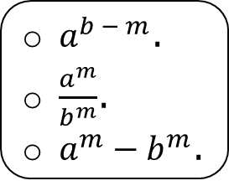
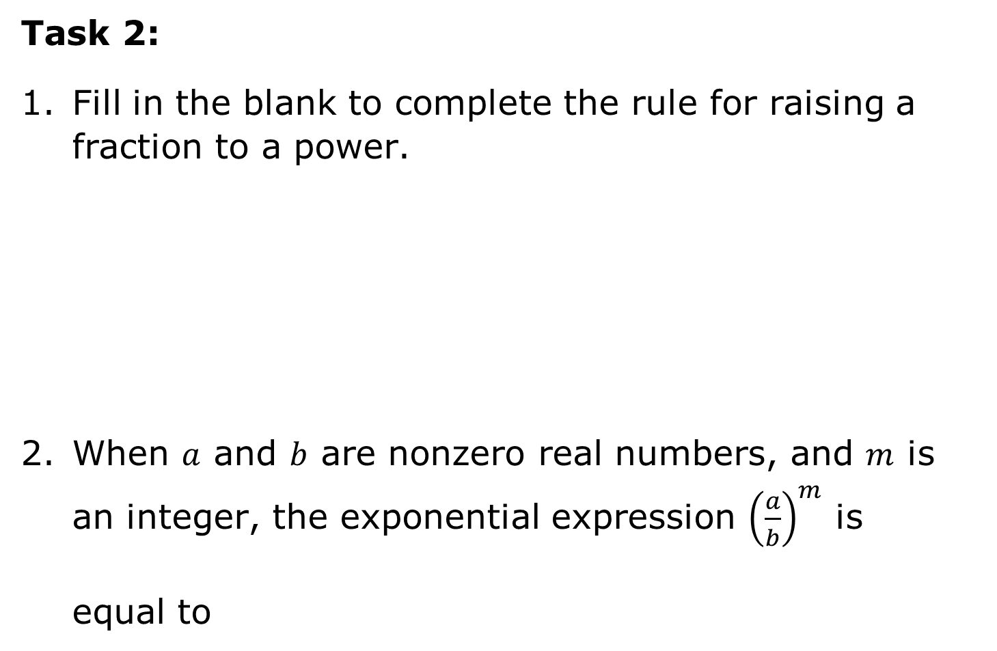
Task 2:
Fill in the blank to complete the rule for raising a fraction to a power.
When $a$ and $b$ are nonzero real numbers, and $m$ is an integer, the exponential expression ${\left(\frac{a}{b}\right)}^{m}$ is equal to
When raising a fraction to a power, the result is equal to the quotient of the numerator and denominator raised separately to the power. This is called the power of a quotient exponent law.
$a^{b − m}$.
$\frac{a^{m}}{b^{m}}$.
$a^{m}{ − b}^{m}$.
volume 2, pg. 12

Slide 16

Task 3: Apply the power of quotient exponent law. Do not simplify the fractions.
${\left(\frac{−4}{8}\right)}^{2}$
${\left(\frac{−4}{−2}\right)}^{6}$
${\left(\frac{2}{−8}\right)}^{5}$
volume 2, pg. 12

Slide 17
Activity
volume 2, pg. 13

Slide 18
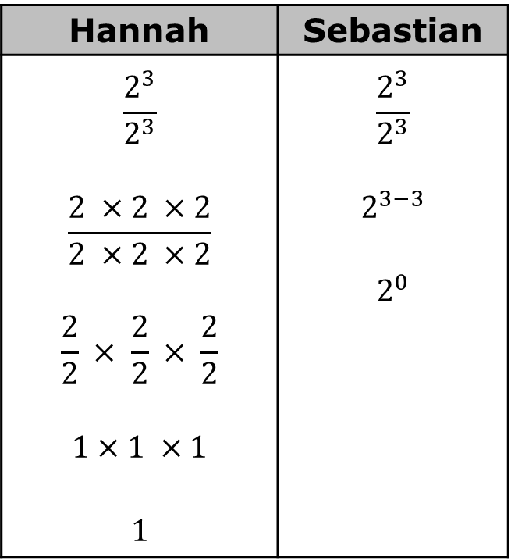

8.2.4 Activity: Station 3: Zero Exponent Law
Task 1: Two students used their understanding of exponents to write an equivalent expression for the exponential expression $\frac{2^{3}}{2^{3}}$.
Discuss each step that the students completed.
Using Hannah’s and Sebastian’s work, make a prediction about the value of any number raised to the power of $0$.
Hannah | Sebastian
$$\frac{2^{3}}{2^{3}}$$ $$\frac{2 ×2 ×2}{2 ×2 ×2}$$ $$\frac{2}{2} × \frac{2}{2} × \frac{2}{2}$$ $$1×1 ×1$$ $$1$$ | $$\frac{2^{3}}{2^{3}}$$ $$2^{3−3}$$ $$2^{0}$$
volume 2, pg. 13

Slide 19
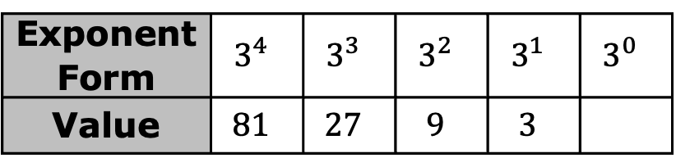
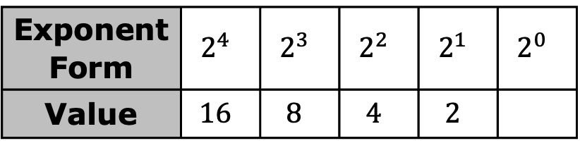
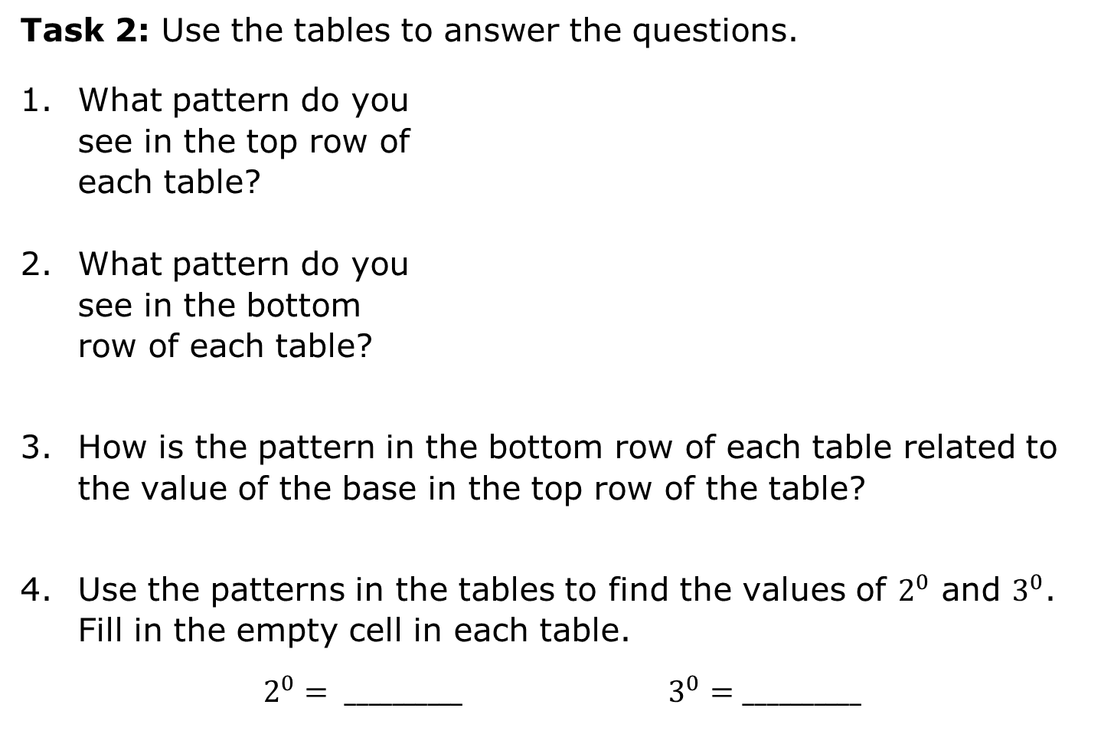
Task 2: Use the tables to answer the questions.
What pattern do you see in the top row of each table?
What pattern do you see in the bottom row of each table?
How is the pattern in the bottom row of each table related to the value of the base in the top row of the table?
Use the patterns in the tables to find the values of $2^{0}$ and $3^{0}$. Fill in the empty cell in each table.
$2^{0}= __________$ $3^{0}=__________$
Exponent Form | $$2^{4}$$ | $$2^{3}$$ | $$2^{2}$$ | $$2^{1}$$ | $$2^{0}$$
Value | $$16$$ | $$8$$ | $$4$$ | $$2$$
Exponent Form | $$3^{4}$$ | $$3^{3}$$ | $$3^{2}$$ | $$3^{1}$$ | $$3^{0}$$
Value | $$81$$ | $$27$$ | $$9$$ | $$3$$
volume 2, pg. 13

Slide 20
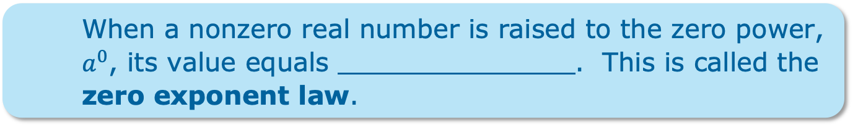
Task 3: Fill in the blank to complete the rule for a base with a zero exponent.
When a nonzero real number is raised to the zero power, $a^{0}$, its value equals . This is called the zero exponent law.
volume 2, pg. 13

Slide 21

Bring It Together
volume 2, pg. 14

Slide 22

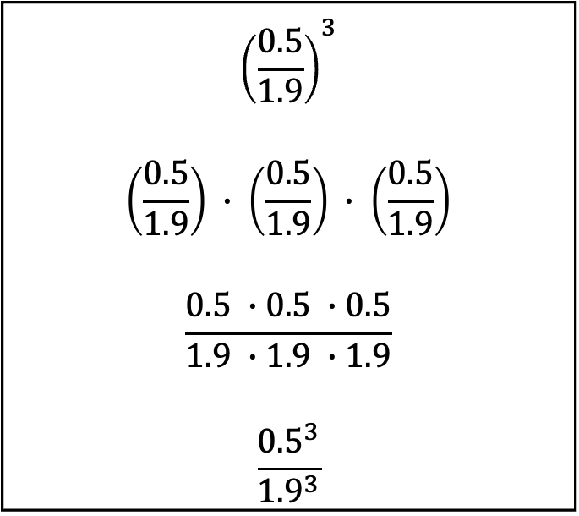
8.2.5 Bring It Together: Exponential Expressions with Rational Bases
Match each set of expressions with the Exponent Law that it demonstrates. Use arrows to indicate matches.
$${\left(\frac{0.5}{1.9}\right)}^{3}$$ $$\left(\frac{0.5}{1.9}\right) ∙ \left(\frac{0.5}{1.9}\right) ∙ \left(\frac{0.5}{1.9}\right)$$ $$\frac{0.5 ∙0.5 ∙0.5}{1.9 ∙1.9 ∙1.9}$$ $$\frac{{0.5}^{3}}{{1.9}^{3}}$$
Zero Exponent Law
Quotient of Powers Law
Power of a Quotient Law
volume 2, pg. 14

Slide 23
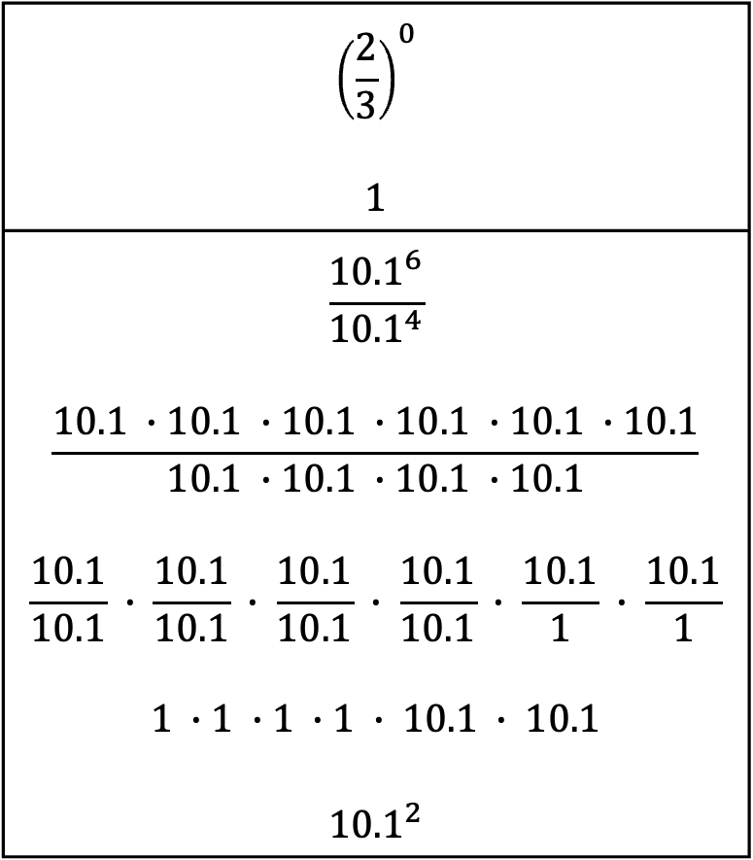
$${\left(\frac{2}{3}\right)}^{0}$$ $$1$$
$$\frac{{10.1}^{6}}{{10.1}^{4}}$$ $$\frac{10.1 ∙10.1 ∙10.1 ∙10.1 ∙10.1 ∙10.1}{10.1 ∙10.1 ∙10.1 ∙10.1}$$ $$\frac{10.1}{10.1} ∙ \frac{10.1}{10.1} ∙ \frac{10.1}{10.1} ∙ \frac{10.1}{10.1} ∙ \frac{10.1}{1} ∙ \frac{10.1}{1}$$ $$1 ∙1 ∙1 ∙1 ∙ 10.1 ∙ 10.1$$ $${10.1}^{2}$$
Zero Exponent Law
Quotient of Powers Law
Power of a Quotient Law
volume 2, pg. 14

Slide 24
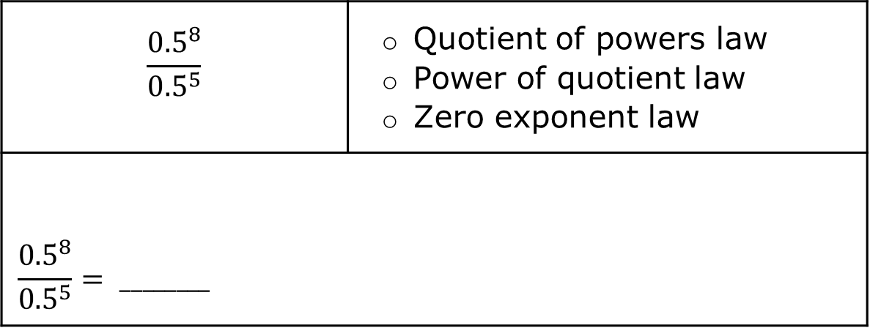
Complete the following steps for each expression.
Rewrite each expression shown by using the laws of exponents.
Check off the exponent law used from the list.
Evaluate the exponential expression.
$$\frac{{0.5}^{8}}{{0.5}^{5}}$$ | Quotient of powers law Power of quotient law Zero exponent law
$$\frac{{0.5}^{8}}{{0.5}^{5}}= ________$$
volume 2, pg. 14

Slide 25
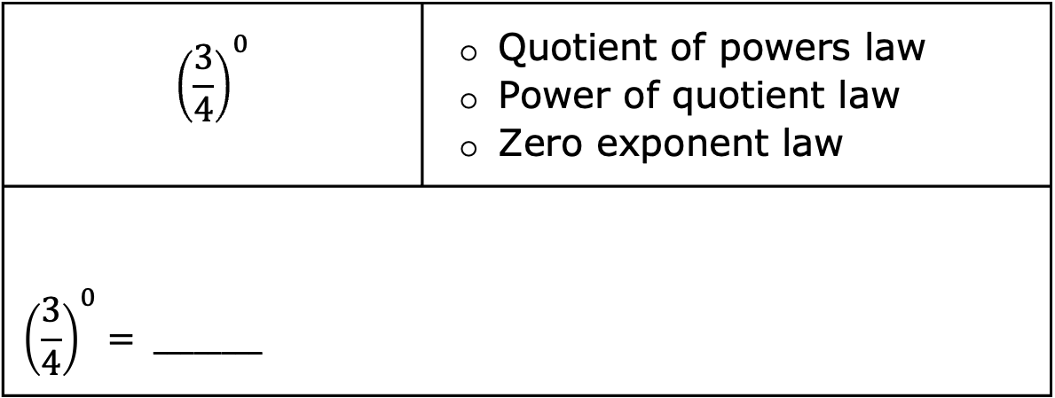
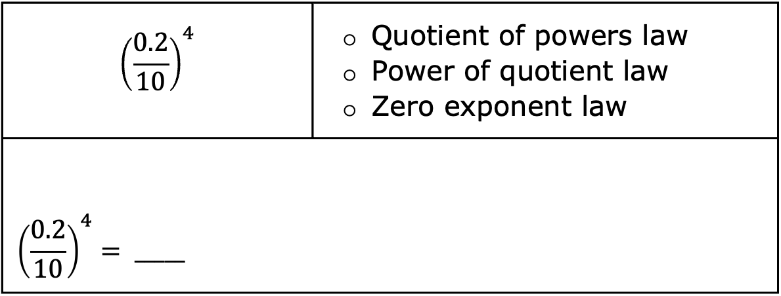
$${\left(\frac{0.2}{10}\right)}^{4}$$ | Quotient of powers law Power of quotient law Zero exponent law
$${\left(\frac{0.2}{10}\right)}^{4}= _____$$
$${\left(\frac{3}{4}\right)}^{0}$$ | Quotient of powers law Power of quotient law Zero exponent law
$${\left(\frac{3}{4}\right)}^{0}= ________$$
volume 2, pg. 14

Slide 26

Your Turn
volume 2, pg. 15

Slide 27
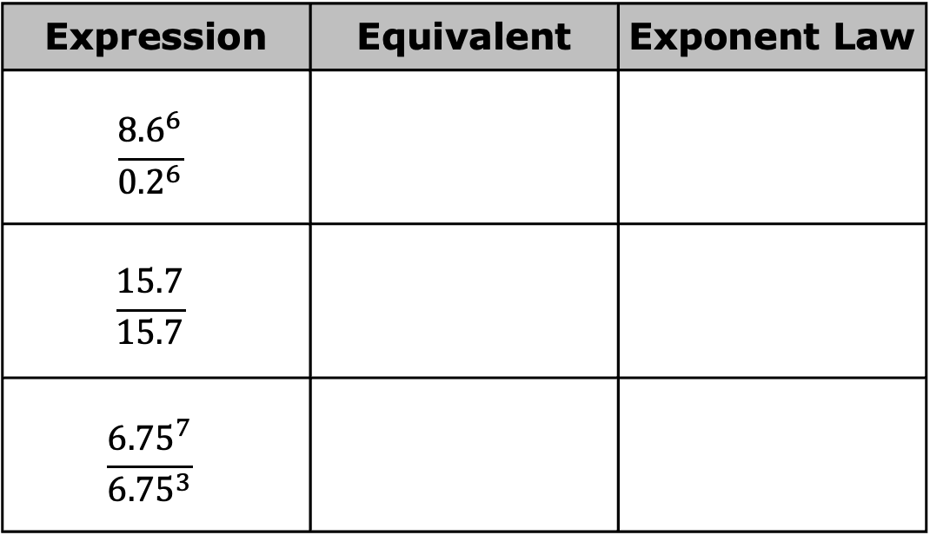
8.2.6 Your Turn!
Rewrite the expressions using laws of exponents. State the exponent law used.
Expression | Equivalent | Exponent Law
$$\frac{{8.6}^{6}}{{0.2}^{6}}$$
$$\frac{15.7}{15.7}$$
$$\frac{{6.75}^{7}}{{6.75}^{3}}$$
volume 2, pg. 15

Slide 28
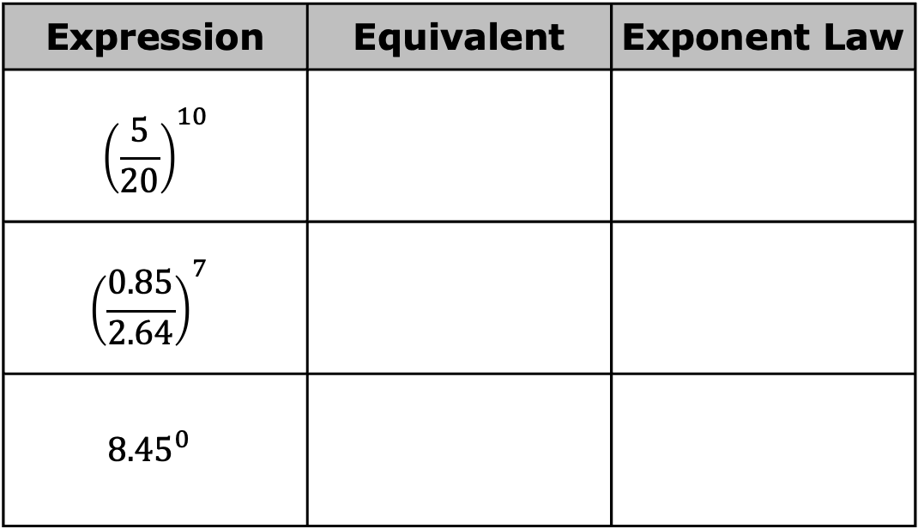
Expression | Equivalent | Exponent Law
$${\left(\frac{5}{20}\right)}^{10}$$
$${\left(\frac{0.85}{2.64}\right)}^{7}$$
$${8.45}^{0}$$
volume 2, pg. 15

Slide 29

Wrap-Up
volume 2, pg. 15

Slide 30
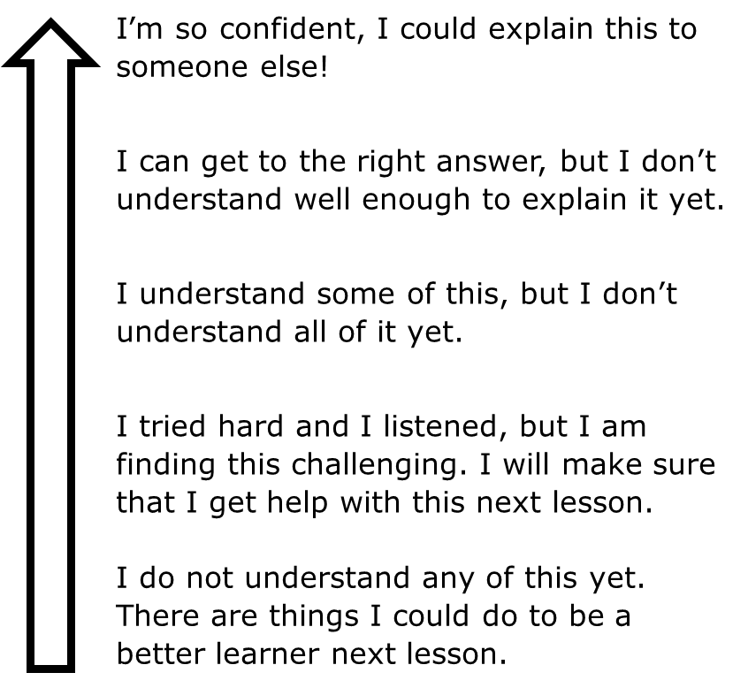
8.2.7 Wrap-Up: Reflection
Shade the arrow up to the statement that best describes your current level of understanding.
volume 2, pg. 15

